Slide 1


Project 3
Salesforce Solution for 'Tours for life'
Thabit Hamror
March 2022

Slide 2
Objects
Object | Implementation
Prospects | Renamed standard Lead object
Travelers | Renamed standard Account object
Trips | Custom Trip object
Purchased Trips | Booking custom and child object of Trips and Travelers
Bus (Fleet) | Child custom object of Trip

Slide 3


Who are my clients?
Field | Individuals | Companies
Fare type | Part of Booking object | Part of Trip object
Traveler's name | Person name | Company name
Solution for individual clients require additional customization

Slide 4
Dashboards
Requirement | Solution
Overview on sales performance | Dashboard for Sales Managers and Sales Reps

Slide 5
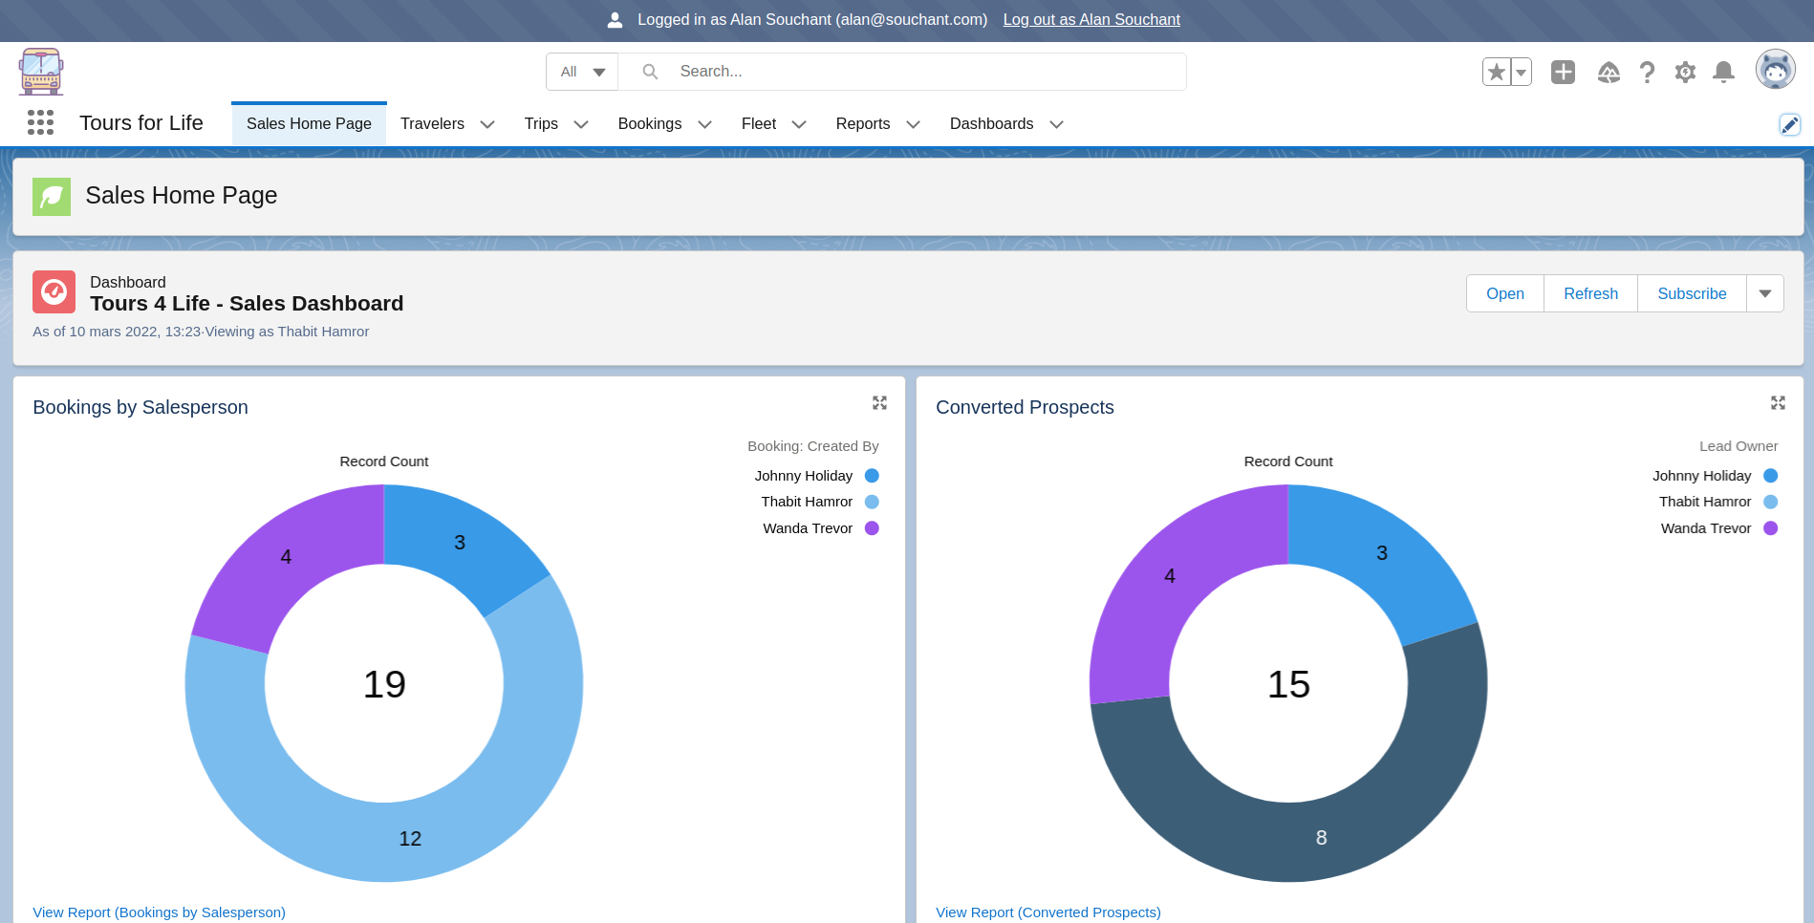
Dashboards : Sales Manager view

Slide 6
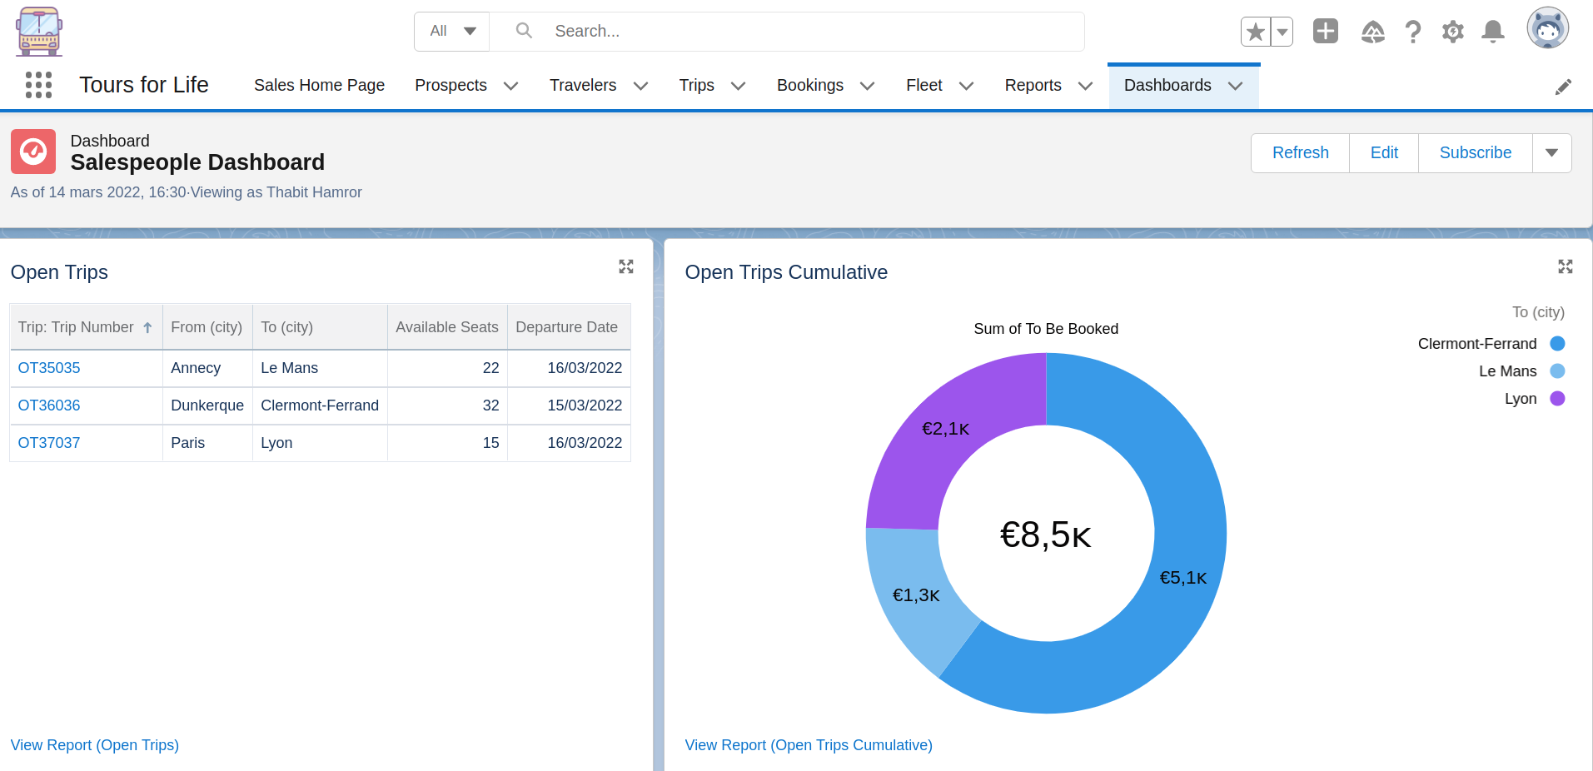
Dashboards : Sales Rep view

Slide 7
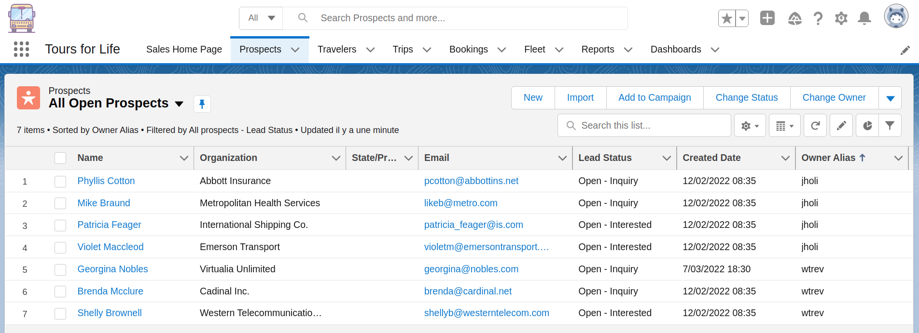
Prospects (Leads)

Slide 8
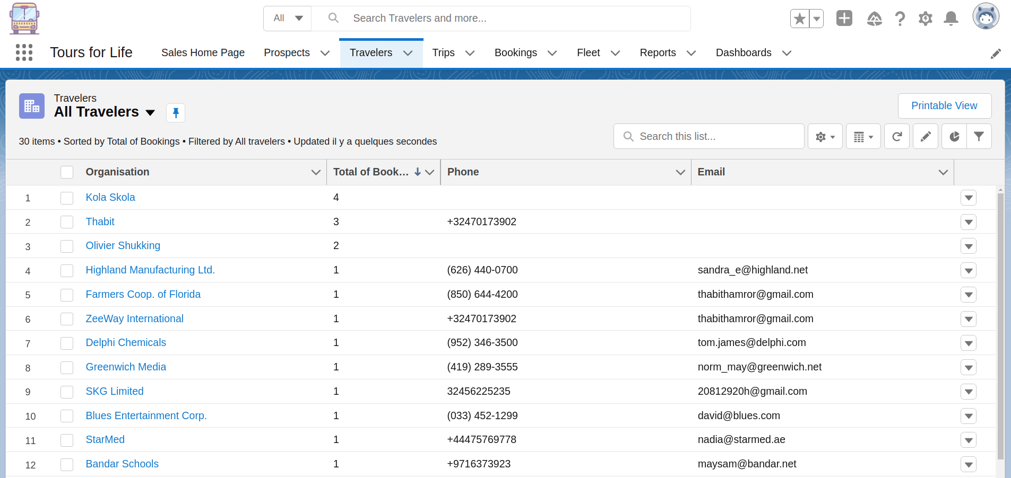
Travelers (Accounts)

Slide 9
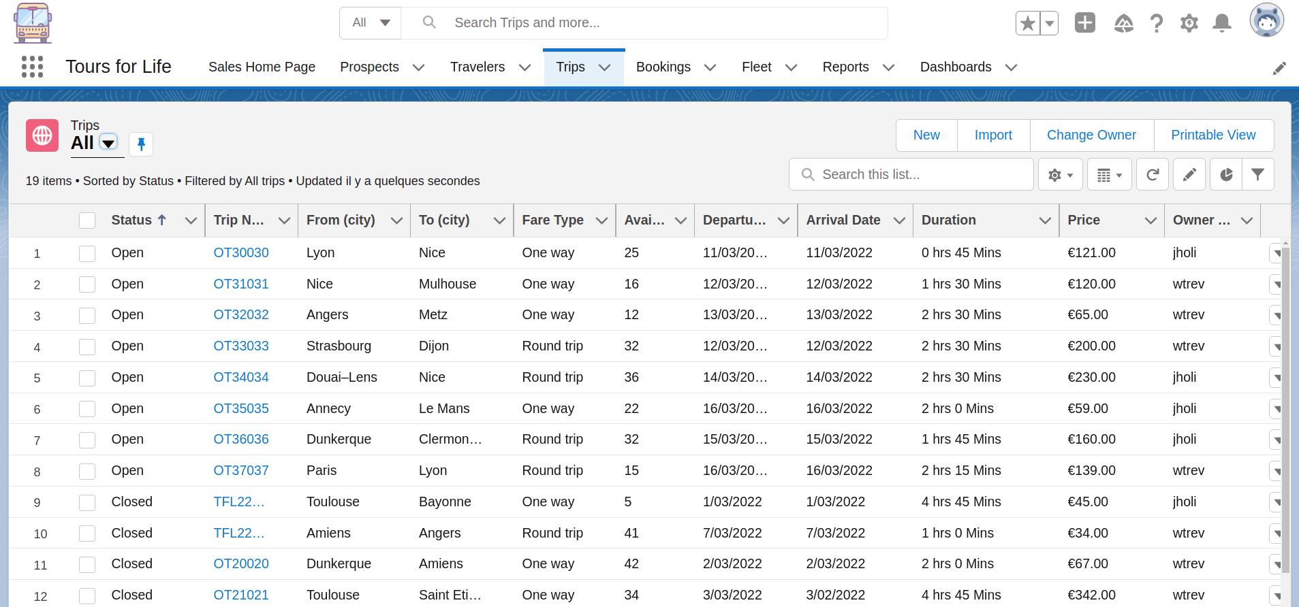
Trips

Slide 10
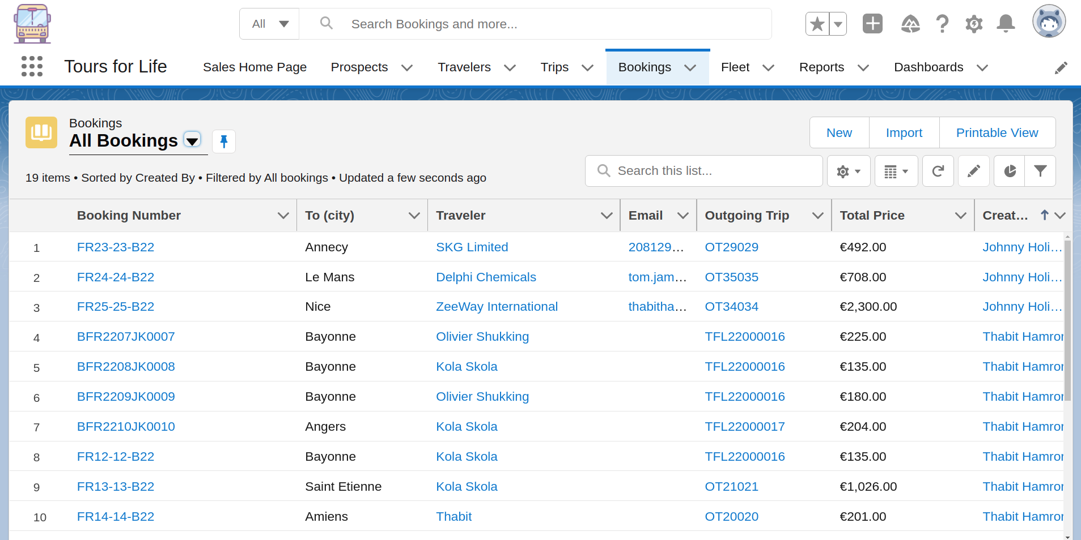
Bookings (Purchased trips)

Slide 11
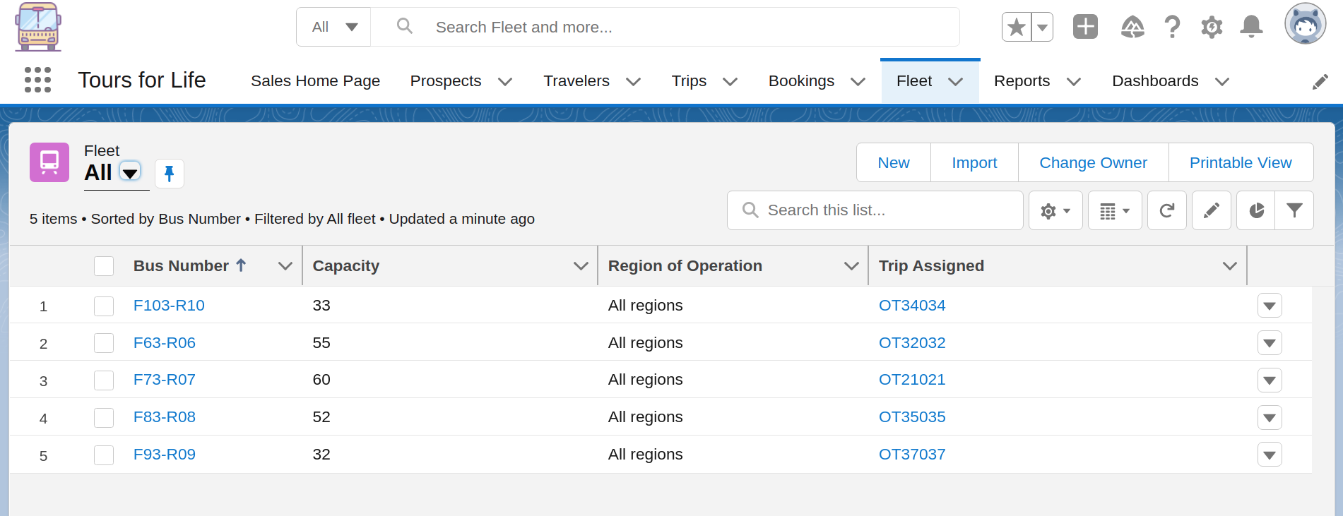
Bus (Fleet)

Slide 12
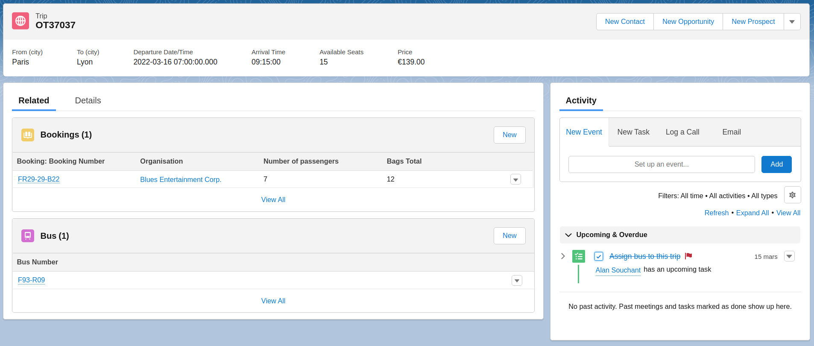
Related & Activities

Slide 13
Roles & Profiles
Requirement | Solution | Support
3 Roles | 1 Sales Manager 2 Sales Reps (North & South) | Any number of users could be assigned to each role
1 - 2 Profiles | Salesforce standard Salesforce platform System Administrator | Standard license required if more than 2 users (including Admin); Platform license could suffice if managers not required to access Lead object

Slide 14
Automation
Requirement | Solution | Support
Update number of available places | Available places = Custom formula field | Seats Booked = Roll-Up summary custom field
Prospect status update email | Email action upon status change for prospect | Flow builder

Slide 15
Additional Automation
Requirement | Solution | Support
Bus assignment task | Bus assignment task assigned to manager once Trip is created | Process builder
Booking confirmation email | Email action upon status change for prospect | Flow builder
Trip status update | Close trip 3 hours before departure date | Workflow rules + flow builder

Slide 16
Mandatory fields
Object | Solution | Example
Standard | Validation rules | Phone and Email fields in the prospect object
Custom | Require check | Any field in the Trip object

